Slide 1
IDS
ML threat detection system
Ruben Pérez

Slide 2
Is your privacy safe?

Slide 3
INDEX
Cybersecurity challenges
Data Science for cybersecurity
Data introduction
Most relevant variables
Models
Evaluation
Conclusions

Slide 4
“There are two types of companies: those that have been hacked, and those that will be.”
Robert Mueller
FBI Director, 2012

Slide 5
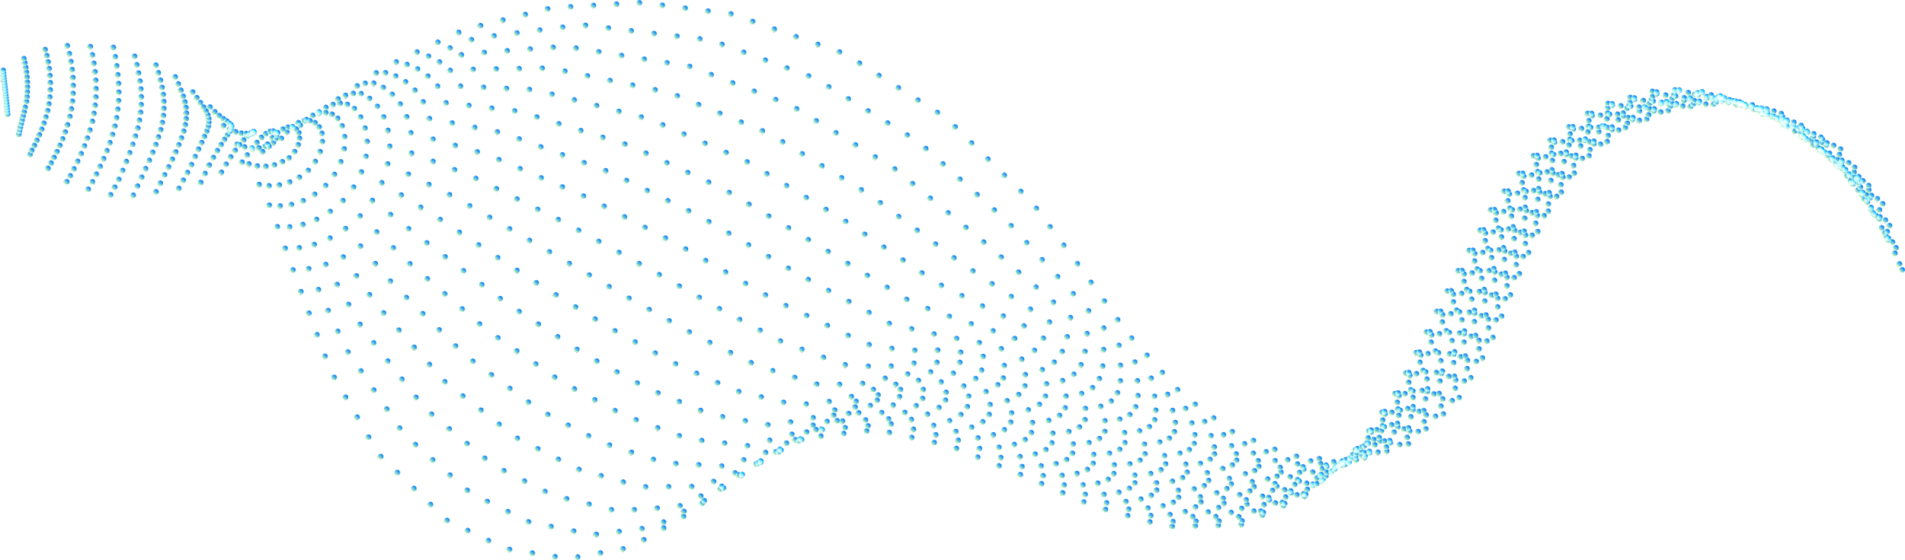



Why is cybersecurity important?
More cybercrimes
Evolving ransomware
Reputational and financial damage
IoT, crypto, cars…

Slide 6

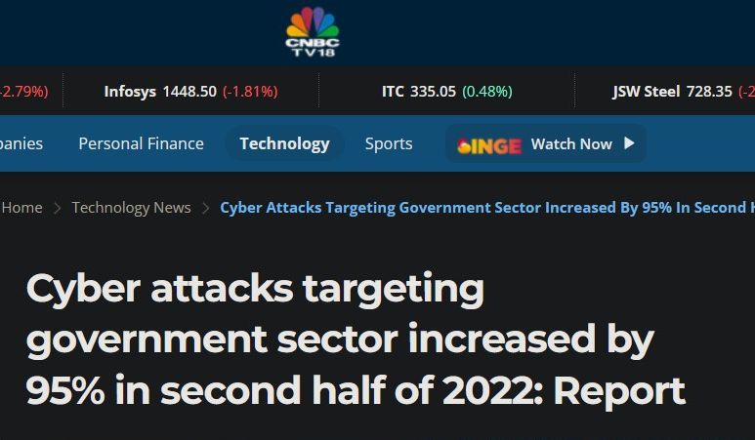

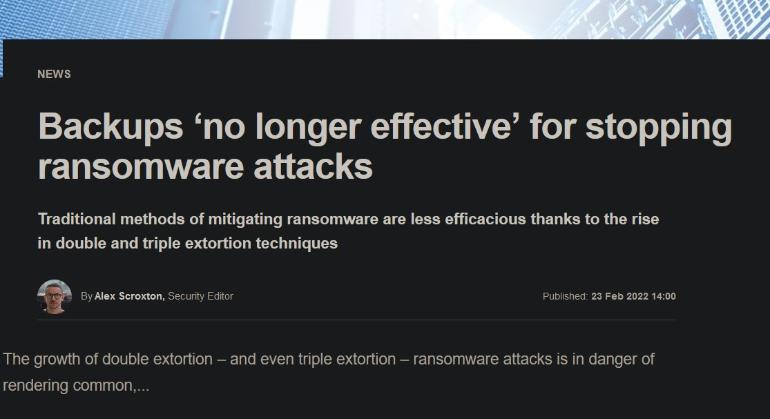
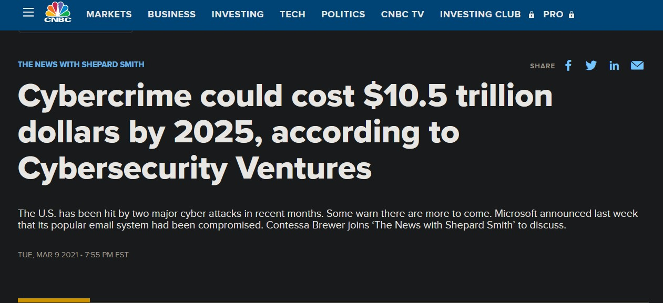
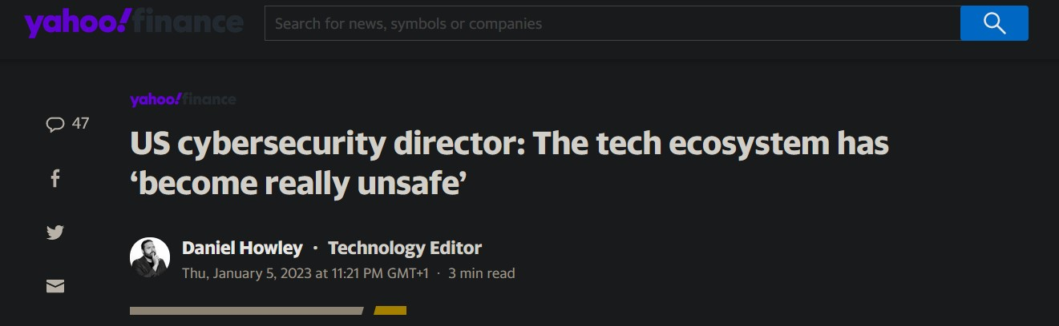
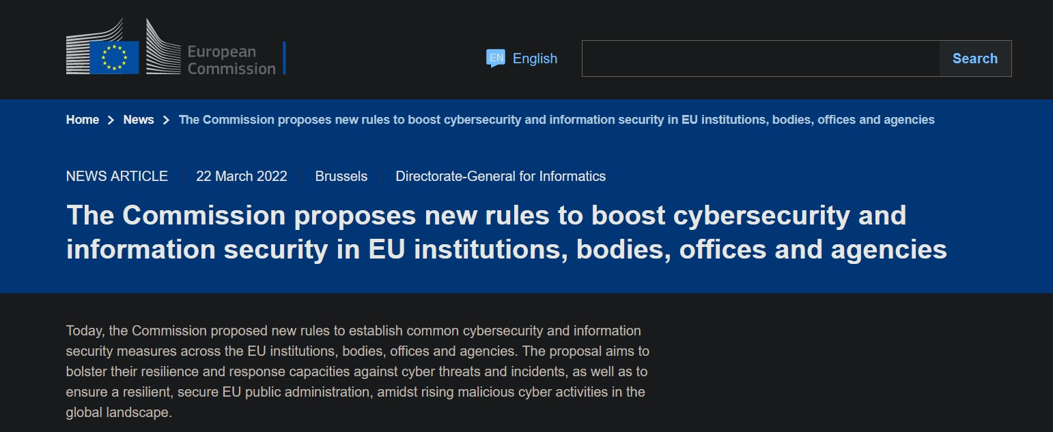
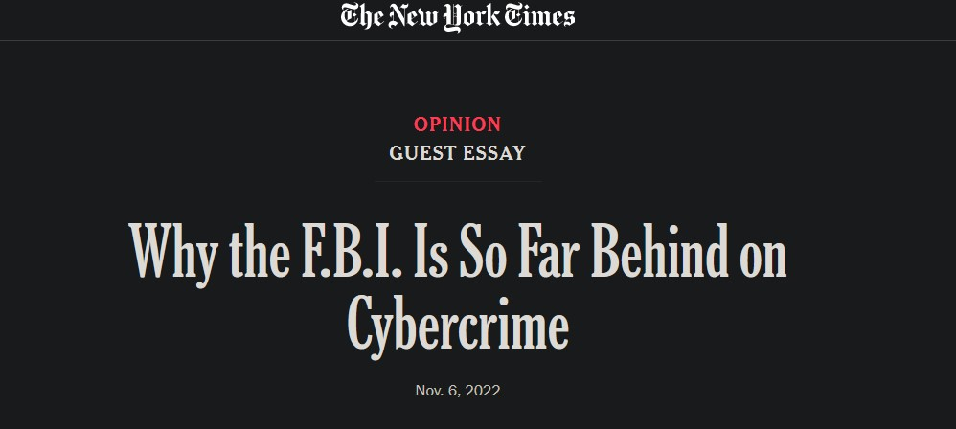

Slide 7


Slide 8

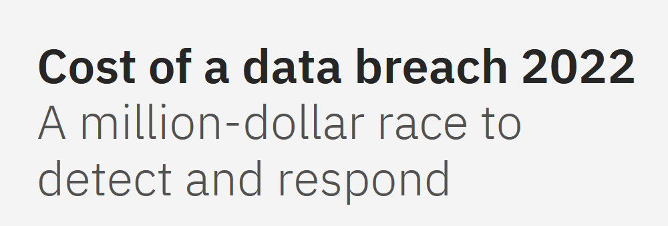
Source: https://www.ibm.com/reports/data-breach

Slide 9
4.82 M
Average cost of a critical infrastucture data breach (usd)

Slide 10
3.05 M
Average cost savings associated with fully deployed security AI

Slide 11
Average cost by security AI deployment level
Not deployed
Partially deployed

Slide 12
Why AI?
Adaptability
Speed
Precision
AI identifies unknown threats and learns over time
Accelerates detection & response times
Can achieve high precision and complexity

Slide 13


Intrusion Detection System

Slide 14
Creation process of our smart protection
1
3
2
4
Data preparation
Evaluation
We obtain the data
Model training

Slide 15
Data
1
UNSW-NB15 dataset

Slide 16

University of New South Wales
Data provided by UNSW University from the research of Moustafa Nour and Jill Slay.
Moustafa Nour and Jill Slay research:
https://ieeexplore.ieee.org/abstract/document/7348942
UNSW dataset:
https://research.unsw.edu.au/projects/unsw-nb15-dataset

Slide 17
14
49
8
Million values in the whole dataset
Features
Attack categories

Slide 18
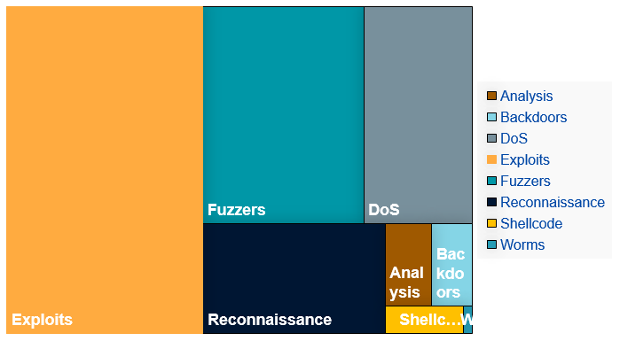
Most frequent attacks

Slide 19
Top threats
Pieces of code that takes advantage of a vulnerability
Random data sending to observe response to find vulnerabilities
Overwhelming a network sending a large number of requests
Information gathering with technical or social engineering
Exploits
Fuzzers
DoS
Reconnaissance

Slide 20
Feature importance
Useful for detecting packets attempting to remain longer than usual.
State + time to live, could be useful for unusual state patterns.
A sudden increase could indicate DoS attack.
High unusual dload could indicate someone is trying to send data as quickly as possible
Source time to live
Ct state time to live
Rate
Destination transfer

Slide 21
Model deployment
Logistic Regression
Random Forest
Boosting
Pipeline 1
Pipeline 2
Feedforward NN
Cross Validation of 5
150 n estimators
XGB, Cat, GradientBoost
SVC, XGB, RF
RF, LR, Gboost, DecisionTree
Reduce LR on plateau

Slide 22
Model Accuracy
0.87
0.96
0.94
ANN
Random Forest
GradientBoost

Slide 23

Applied AI isn’t the future; It’s the present

Slide 24
END

